Slide 1
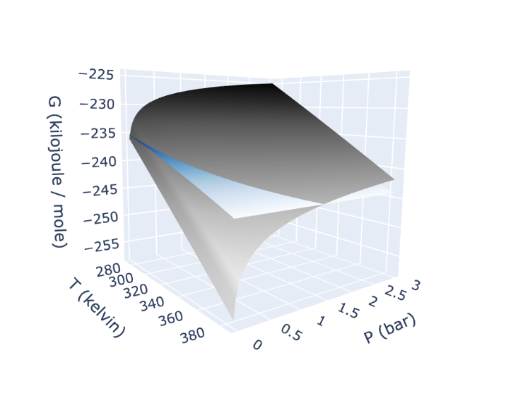
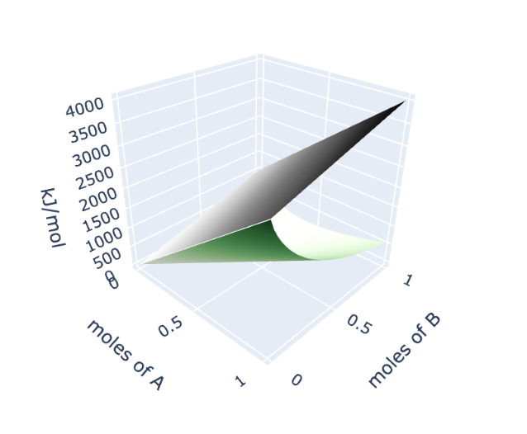
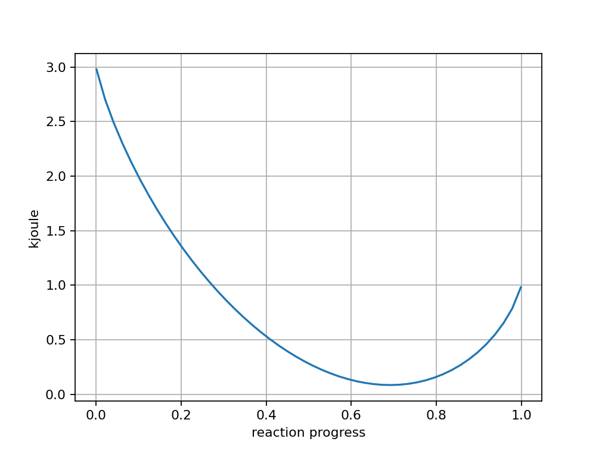

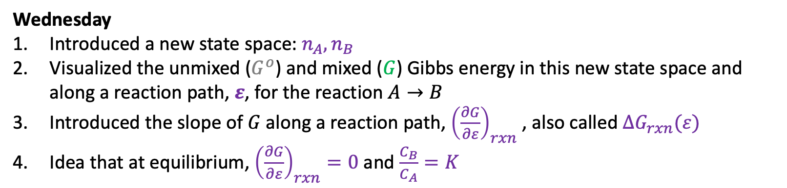

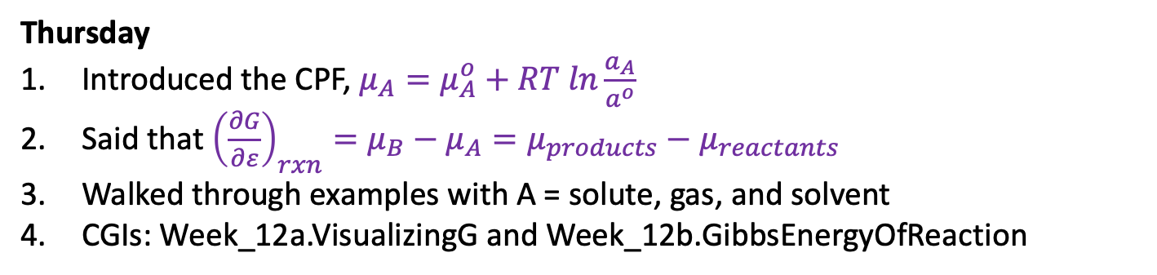
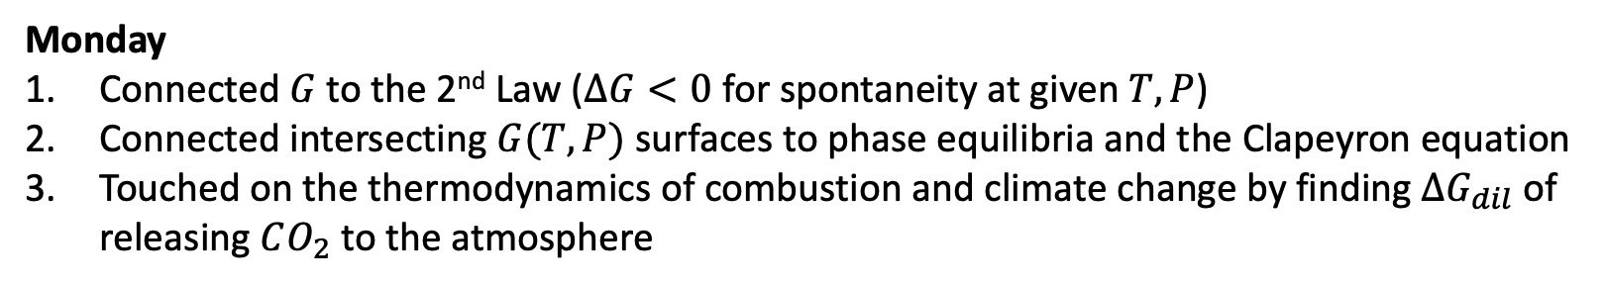
Recap of the week
Monday
Connected $G$to the 2nd Law ($∆G<0$ for spontaneity at given $T,P$)
Connected intersecting $G(T,P)$ surfaces to phase equilibria and the Clapeyron equation
Touched on the thermodynamics of combustion and climate change by finding $∆G_{dil}$ of releasing $CO_{2}$ to the atmosphere
Gas
Liquid
Wednesday
Introduced a new state space: $n_{A},n_{B}$
Visualized the unmixed ($G^{o}$) and mixed ($G$) Gibbs energy in this new state space and along a reaction path, $ε$, for the reaction $A→B$
Introduced the slope of $G$ along a reaction path, ${\left(\frac{∂G}{∂ε}\right)}_{rxn}$ , also called $∆G_{rxn}(ε)$
Idea that at equilibrium, ${\left(\frac{∂G}{∂ε}\right)}_{rxn}=0$ and $\frac{C_{B}}{C_{A}}=K$
$$G^{o}$$
$$G$$
Thursday
Introduced the CPF, $μ_{A}=μ_{A}^{o}+RT ln\frac{a_{A}}{a^{o}}$
Said that ${\left(\frac{∂G}{∂ε}\right)}_{rxn}=μ_{B}−μ_{A}=μ_{products}−μ_{reactants}$
Walked through examples with A = solute, gas, and solvent
CGIs: Week_12a.VisualizingG and Week_12b.GibbsEnergyOfReaction

Slide 2
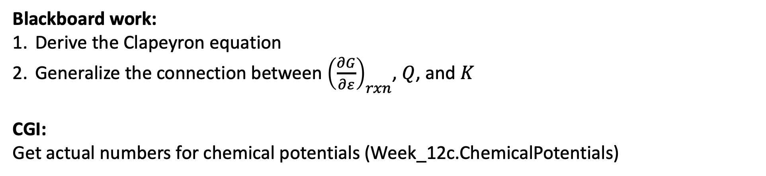
Today
Blackboard work:
Derive the Clapeyron equation
Generalize the connection between ${\left(\frac{∂G}{∂ε}\right)}_{rxn}$, $Q$, and $K$
CGI:
Get actual numbers for chemical potentials (Week_12c.ChemicalPotentials)

Slide 3
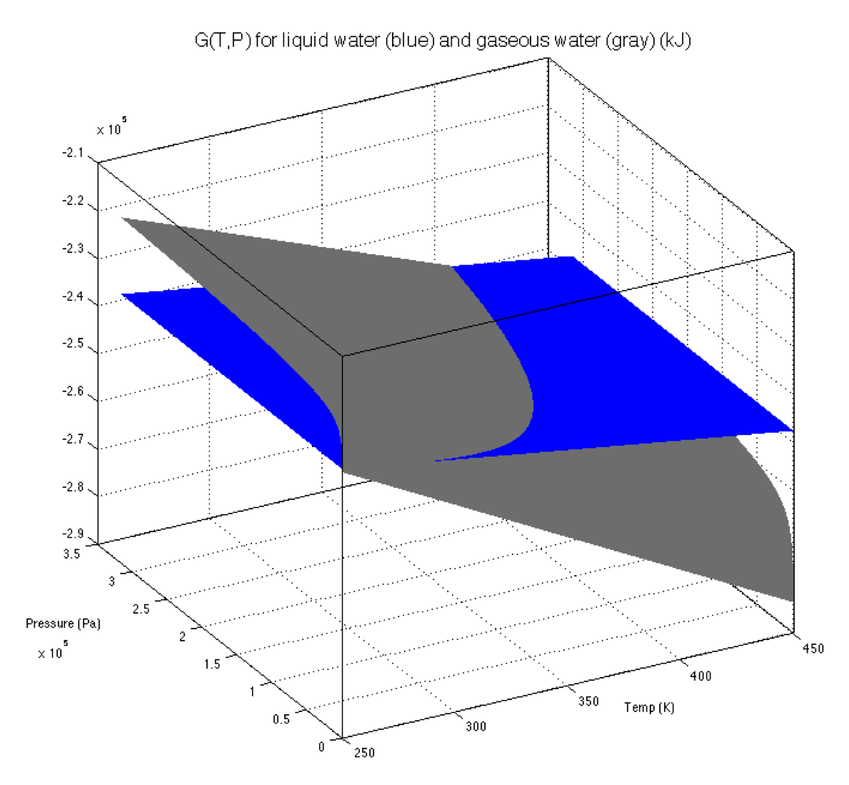
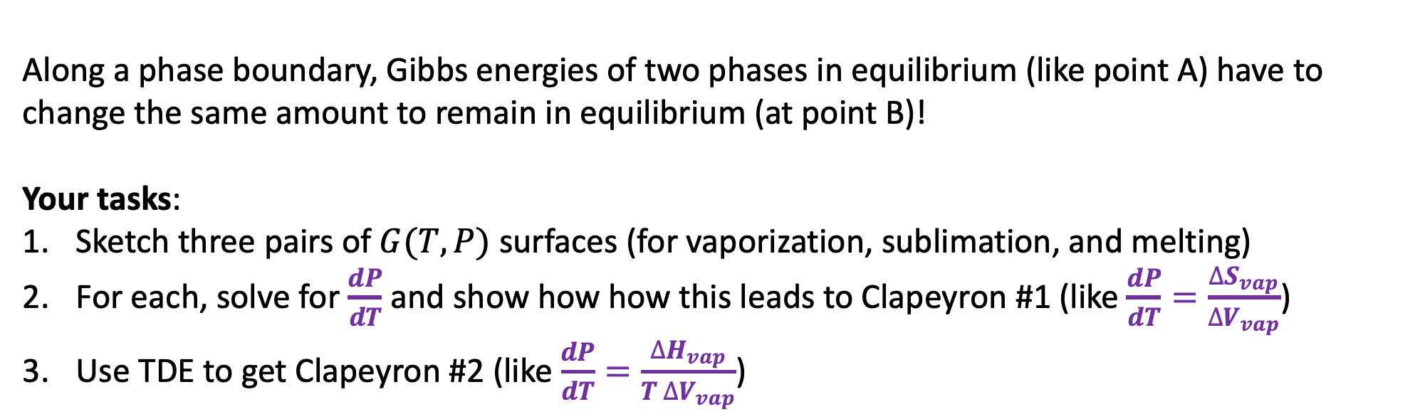
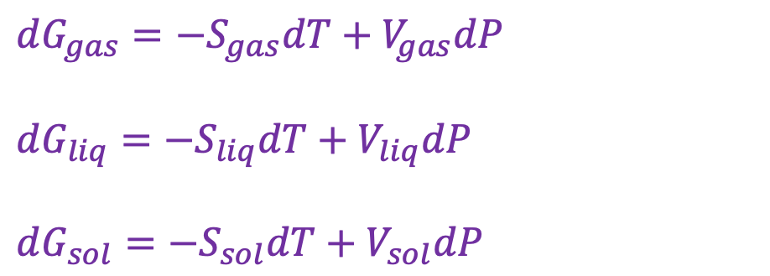
Deriving the Clapeyron equation
$dG_{gas}=−S_{gas}dT+V_{gas}dP$
$dG_{liq}=−S_{liq}dT+V_{liq}dP$
$dG_{sol}=−S_{sol}dT+V_{sol}dP$
B
A
Along a phase boundary, Gibbs energies of two phases in equilibrium (like point A) have to change the same amount to remain in equilibrium (at point B)!
Your tasks:
Sketch three pairs of $G(T,P)$ surfaces (for vaporization, sublimation, and melting)
For each, solve for $\frac{dP}{dT}$ and show how how this leads to Clapeyron #1 (like $\frac{dP}{dT}=\frac{∆S_{vap}}{∆V_{vap}}$)
Use TDE to get Clapeyron #2 (like $\frac{dP}{dT}=\frac{∆H_{vap}}{T ∆V_{vap}}$)

Slide 4
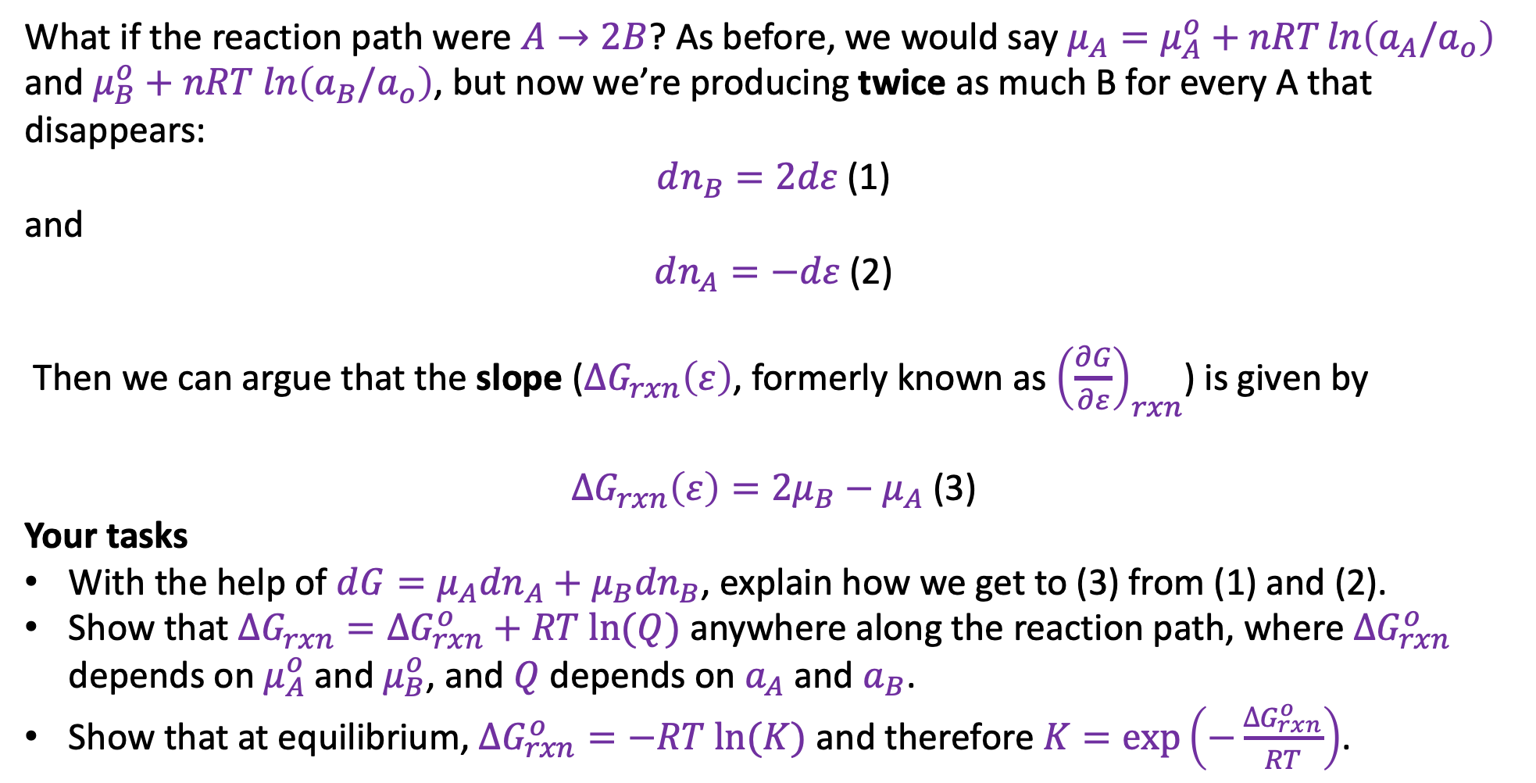
2. Generalizing the connection between ${\left(\frac{∂G}{∂ε}\right)}_{rxn}$, $∆G_{rxn}\left(ε\right)$, $Q$, and $K$
What if the reaction path were $A→2B$? As before, we would say $μ_{A}=μ_{A}^{o}+nRT\ln\left(a_{A}/a_{o}\right)$ and $μ_{B}^{o}+nRT ln\left(a_{B}/a_{o}\right)$, but now we’re producing twice as much B for every A that disappears:
$dn_{B}=2dε$ (1)
and
$dn_{A}=−dε$ (2)
Then we can argue that the slope ($∆G_{rxn}\left(ε\right)$, formerly known as ${\left(\frac{∂G}{∂ε}\right)}_{rxn}$) is given by
$∆G_{rxn}\left(ε\right)={2μ}_{B}−μ_{A}$ (3)
Your tasks
With the help of $d{G=μ_{A}dn}_{A}+{μ_{B}dn}_{B}$, explain how we get to (3) from (1) and (2).
Show that $∆G_{rxn}=∆G_{rxn}^{o}+RT ln⁡(Q)$ anywhere along the reaction path, where $∆G_{rxn}^{o}$ depends on $μ_{A}^{o}$ and $μ_{B}^{o}$, and $Q$ depends on $a_{A}$ and $a_{B}$.
Show that at equilibrium, $∆G_{rxn}^{o}=−RT ln⁡(K)$ and therefore $K=\exp\left(−\frac{∆G_{rxn}^{o}}{RT}\right)$.

